Slide 1
Dictionaries
{ : }

Slide 2
Dictionaries:
An unordered collection of items.
Each item of a dictionary has a {key : value} pair.
How to create a dictionary and access its items.
Mutable (can be changed).
Flexible in the data types they can hold.

Slide 3
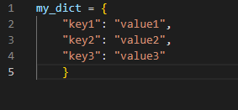
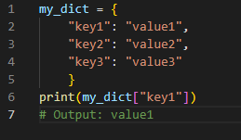
Create a dictionary
Access its items

Slide 4
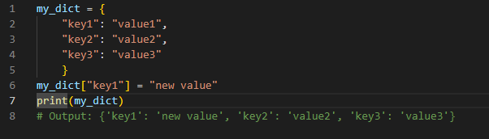
Mutability of a dictionary

Slide 5
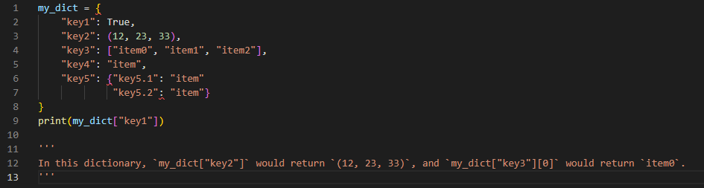
Dictionaries are very flexible in the data types they can hold.

